Slide 1
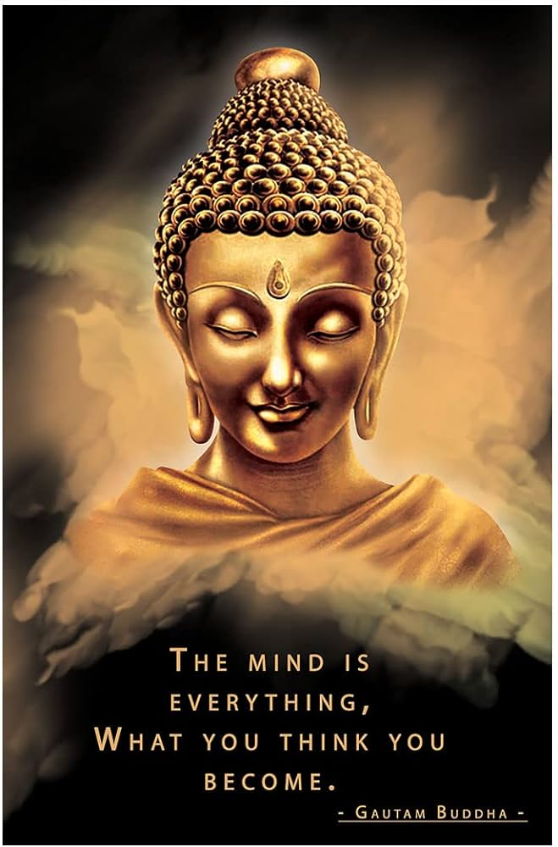
Motivation
Motivation is the driving force behind human behaviour, pushing individuals to take action and achieve their goals

Slide 2
Motivation
The word “motivation” comes from the Latin word “movere”, which means move.
Motivation refers to the strategies and techniques used to inspire and encourage employees to perform their best and contribute to the success of the organization through Understanding Individual Needs, Recognition and Rewards, Creating a Positive Work Environment, Empowering Employees, Providing Regular Feedback etc.
Motivation plays a crucial role in management as it directly impacts employee performance, job satisfaction, and overall productivity.
Psychological Process
Motivation is goal-oriented;
Motivation is a continuous process;
Motivation may be positive or negative;
Motivation may be monetary or non-monetary;
Motivation may Complex process
Characteristics/ Features of Motivation

Slide 3
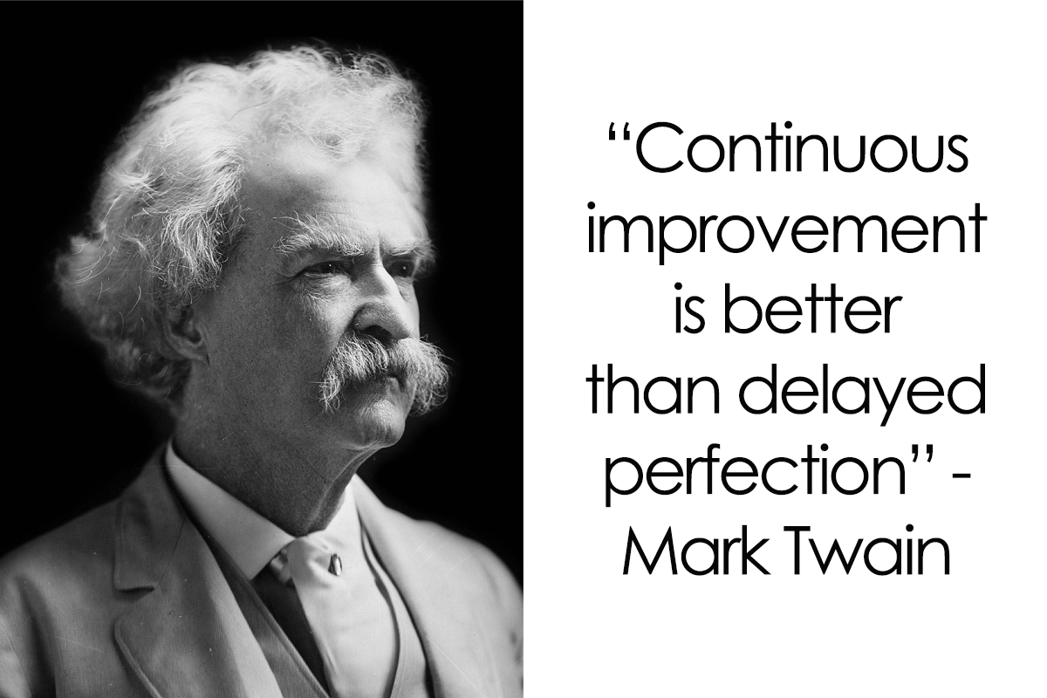

Slide 4
Evaluation of performance( Verify)
Good Behaviour of the Higher Level Authority
Process of Motivation
Training and development With Recognition of Good Work
Security of Job and promotion
Increasing in facilities
Analyse the tension and factors of demotivation.
Determination of needs of dissatisfaction

Slide 5
Important of Motivation
Removal of Apathy
Increase in Efficiency and Output
Optimum Utilisation of the Resources
Understanding the Employees’ Needs
Low Employee Turnover and Absenteeism
Better Industrial Relations
Facilitating Other Functions of Management
Acceptance of Organisational Changes

Slide 6
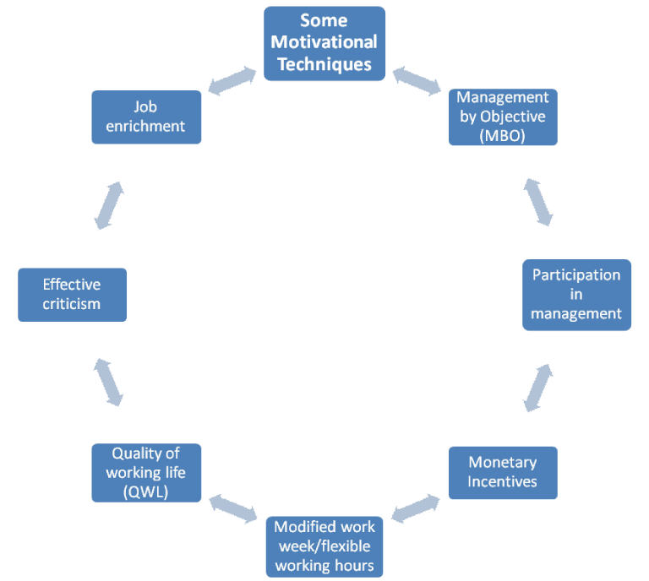
Motivation is essential to increase the workability of employees/workers and the workability of the employee is essential for the organization’s success. So here we discuss some special motivational techniques for worker.

Slide 7
Management by Objective (MBO) and goal setting
MBO is a process of collaborative goal-setting between a manager and a subordinate with the understanding that the degree of goal attainment by the subordinate will be a major factor in evaluating and rewarding the subordinate’s performance.
When the manager sits with the subordinates, jointly established goals for them, and agrees that the future rewards will be based on goal attainment then he or she is expected to be more motivated to work toward the goals that merit them.
Participation in management
Subordinates are likely to be motivated the most when they are not only consulted but are also allowed to participate in decision-making. In fact, the right kind of participation yields both motivation and knowledge valuable for enterprise success. Participation appeals to the need for affiliation and acceptance. It is a means of recognition and thus enhances subordinate’s eagerness to work harder.
Monetary Incentives
An enterprise can make its wages and salaries competitive within its industry and its geographic area to attract and hold people.
People usually evaluate their compensation in light of what their equals are receiving.
Unless bonuses for mangers are based to a major extent on individual performance, an enterprise is not buying much motivation with them. In so far as possible, compensation has to be based on performance.
Money can motivate only when the prospective payment is large relative to a person’s income.

Slide 8
Modified work week/flexible working hours
Modified workweeks give employees the opportunity to fulfill a variety of needs. Using flexible working hours, a person can contribute to the organization and still have time, for example, to study for the MBA programmed for executives or to carry on business as a part-time occupation.
Quality of working life (QWL)
This is an important motivational technique, used by managers in western societies. Mangers have regarded QWL as a promising means of dealing with stagnation productivity. Workers and trade union leaders have also seen it as a way to improve working conditions and productivity and also as a means of justifying higher pay. It may also help to minimize labor disputes and to ensure industrial democracy.
Effective criticism
This can be a springboard for improving an employee’s behavior and performance. Adopting a positive approach makes criticism less difficult as well as more effective. The manager should examine his or her own motives before criticizing it.
Job enrichment
Making jobs challenging and meaningful is an accepted way of motivating employees greatly. In job enrichment, the attempt is to build into jobs a higher sense of challenge and achievement. Jobs may be enriched by varieties of way such as giving workers freedom, chances of participation, feedback parsing etc.

Slide 9
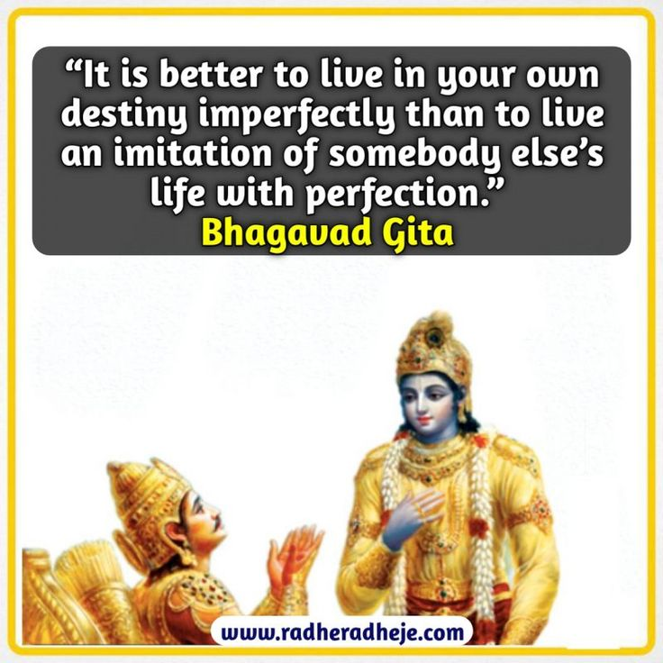
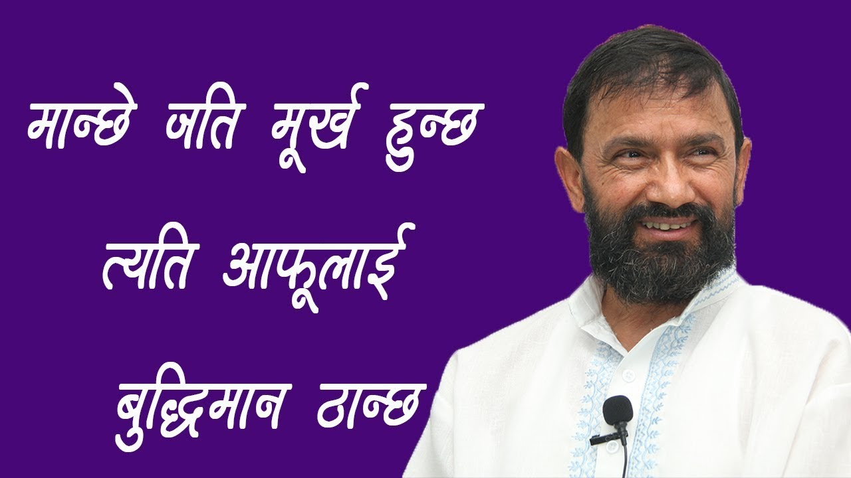
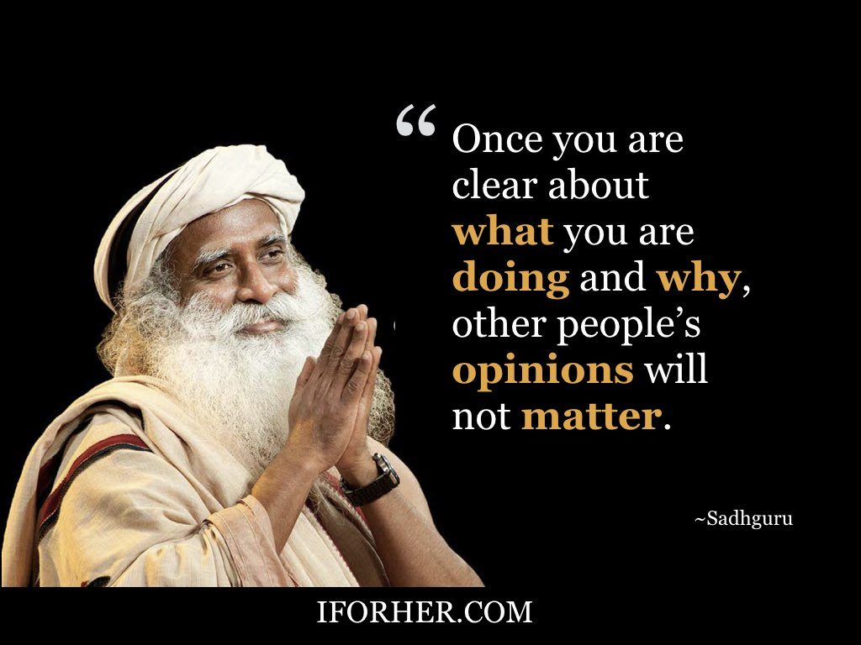
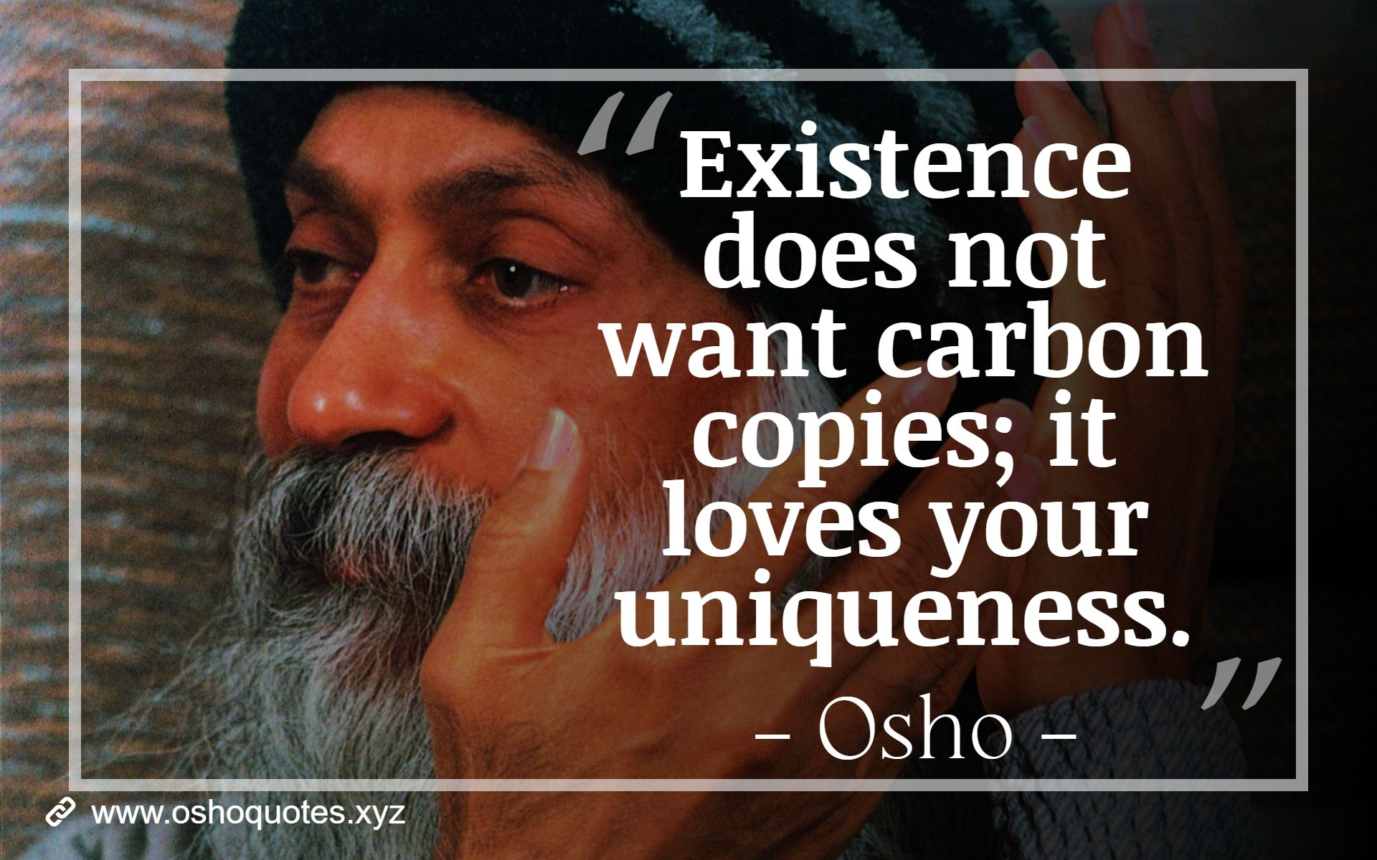

Slide 10

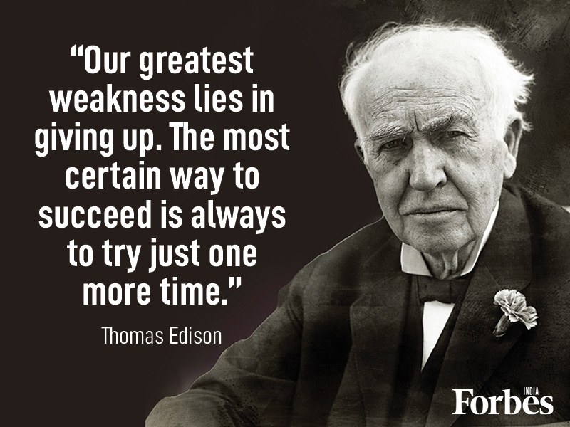
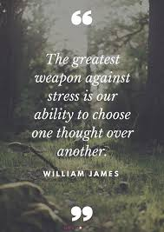
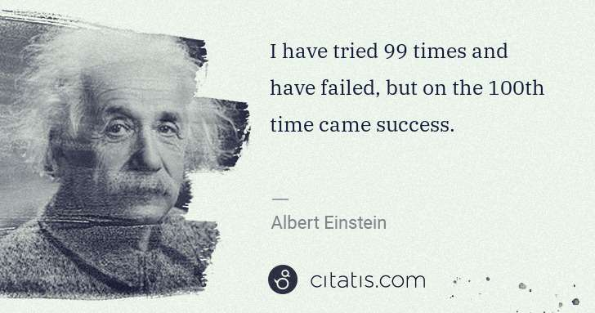

Slide 11
“When one door of happiness closes, another opens, but often we look so long at the closed door that we do not see the one that has been opened for us.” - Helen Keller
“The future depends on what you do today.” - Mahatma Gandhi
It does not matter how slowly you go, so long as you do not stop.” – Confucius
“Believe you can and you’re halfway there.” - Theodore Roosevelt
“Learn from the mistakes of others. You can’t live long enough to make them all yourselves.” – Chanakya
“Success only comes to those who dare to attempt.” - Mallika Tripathi
“If I had eight hours to chop down a tree, I’d spend six hours sharpening my ax.” - Abraham Lincoln
“We are what we repeatedly do. Excellence, therefore, is not an act. But a habit.” – Aristotle
“Your imagination is your preview of life’s coming attractions.” - Albert Einstein
“Just one small positive thought in the morning can change your whole day.” - Dalai Lama

Slide 12
“Start by doing what’s necessary, then what’s possible; and suddenly you are doing the impossible.” - Saint Francis
“The only thing that overcomes hard luck is hard work.” - Harry Golden
“Setting goals is the first step in turning the invisible into visible.” - Tony Robbins
“Build your own dreams or someone else will hire you to build theirs.” - Farrah Gray
“Light tomorrow with today.” - Elizabeth Barrett Browning
“Someday is not a day of the week.” - Janet Dailey
Success is the sum of small efforts repeated day in and day out.” - Robert Collier
“Once you have commitment, you need the discipline and hard work to get you there.” - Haile Gebrselassie
”Spend eighty percent of your time focusing on the opportunities of tomorrow rather than the problems of yesterday.” - Brian Tracy
“You always have two choices: your commitment versus your fear.” - Sammy Davis Jr.

